Slide 1
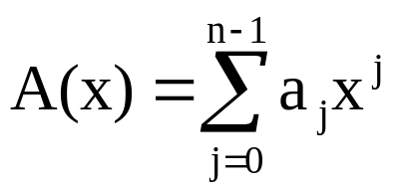
Chapter 30: Polynomials and the FFT
Polynomial:
coefficient: complex, e.g.,
3.25 + 6.999i
√-1
real part imaginary part
Degree-bound is n.
Degree is k if a_{k} is the highest nonzero coefficient.

Slide 2
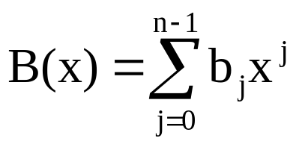
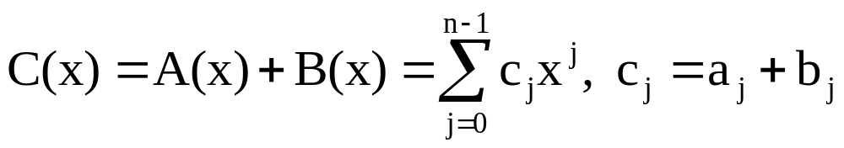
Polynomial Addition
Θ(n) time to compute.

Slide 3
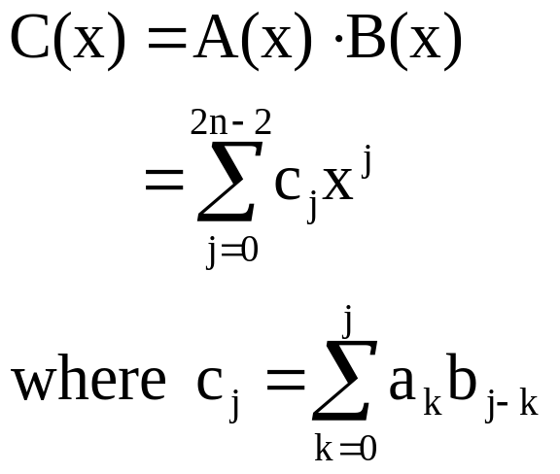
Polynomial Multiplication
called convolution
Note: Degree bound of C(x) is 2n – 1.
Straightforward computation takes Θ(n²) time.

Slide 4
Example
6x³ + 7x² – 10x + 9
–2x³ + 4x – 5
–30x³ – 35x² + 50x – 45
24x⁴ + 28x³ – 40x² + 36x
–12x⁶ – 14x⁵ + 20x⁴ – 18x³
–12x⁶ – 14x⁵ + 44x⁴ – 20x³ – 75x² + 86x – 45

Slide 5
Faster Multiplication
Using the FFT, can multiply two polynomials in Θ(n lg n) time.
Idea: Represent polynomials in a way that allows faster
multiplication.
  1. Convert to new representation.
  2. Multiply in Θ(n) time.
  3. Convert back.
Want these steps to run in Θ(n lg n) time.

Slide 6
Representation of Polynomials
Coefficient Representation:
Advantages:
  1) Can evaluate at any point x₀ in Θ(n) time using Horner’s Rule:
    A(x₀) = a₀ + x₀(a₁ + x₀(a₂ + … + x₀(a_{n-2} + x₀(a_{n-1})) … ))
  2) Can add in Θ(n) time.
Multiplication is a problem.
Point-Value Representation: {(x₀, y₀), (x₁, y₁), …, (x_{n-1}, y_{n-1})},
where x_{k}’s are distinct and y_{k} = A(x_{k}).
Converting from coefficient to P-V using Horner’s Rule takes
Θ(n²) time. We want to do it in Θ(n lg n) time.

Slide 7
Addition and Multiplication in P-V
Addition: C(x) = A(x) + B(x)
  A: {(x₀, y₀), (x₁, y₁), …, (x_{n-1}, y_{n-1})}
  B: {(x₀, y′₀), (x₁, y′₁), …, (x_{n-1}, y′_{n-1})}
  C: {(x₀, y₀ + y′₀), (x₁, y₁ + y′₁), …, (x_{n-1}, y_{n-1} + y′_{n-1})}
Can compute C in in Θ(n) time.
Multiplication: C(x) = A(x) B(x)
Must “extend” A and B to 2n P-V pairs:
  A: {(x₀, y₀), (x₁, y₁), …, (x_{2n-1}, y_{2n-1})}
  B: {(x₀, y′₀), (x₁, y′₁), …, (x_{2n-1}, y′_{2n-1})}
  C: {(x₀, y₀ y′₀), (x₁, y₁ y′₁), …, (x_{2n-1}, y_{2n-1} y′_{2n-1})}
Also takes Θ(n) time.
Actually need only
2n–1 pairs, but we
assume 2n for
simplicity.

Slide 8
Strategy for Multiplying Polynomials
a₀, a₁, …, a_{n-1}
b₀, b₁, …, b_{n-1}
Ordinary multiplication
Θ(n²) time
Coeff.
Rep.
c₀, c₁, …, c_{2n-2}
Evaluation
Θ(n lg n) time
Interpolation
Θ(n lg n) time
A(ω_{2n}⁰), B(ω_{2n}⁰)
A(ω_{2n}¹), B(ω_{2n}¹)

A(ω_{2n}^{2n-1}), B(ω_{2n}^{2n-1})
C(ω_{2n}⁰)
C(ω_{2n}¹)

C(ω_{2n}^{2n-1})
Pointwise multiplication
Θ(n) time
P.V.
Rep.
Note: Powerpoint doesn’t do a great job with combination
subscripts/superscripts. See book for how this is supposed to look.
The “n” you see in subsequent slides corresponds to “2n” here.

Slide 9
The DFT and FFT
We convert from coeff. to PV by evaluating at the n complex n^{th}
roots of unity.
Denote as ω_{n}⁰, ω_{n}¹, …, ω_{n}^{n-1}.
ω_{n}^{k} = e^{2πik/n}.
We have (ω_{n}^{k} )^{n} = 1 for each k.
Proof:
(ω_{n}^{k} )^{n} = e^{2πik}
= cos(2πk) + i sin(2πk), follows from e^{iu} = cos(u) + i sin(u).
= 1
Principle n^{th} root of unity: ω_{n} = e^{2πi/n}.
  Other roots are powers of this one.

Slide 10
Example
ω₈²
ω₈³
i
ω₈¹
ω₈⁴
ω₈⁰ = ω₈⁸
–1
1
ω₈⁵
ω₈⁷
–i
ω₈⁶
The values of ω₈⁰, ω₈¹, …, ω₈⁷ in the complex plane, where
ω₈ = e^{2πi/8} is the principle 8th root of unity.

Slide 11
Cancellation Lemma
Lemma 30.3: For all n ≥ 0, k ≥ 0, and d > 0: ω_{dn}^{dk} = ω_{n}^{k}.
Proof:
ω_{dn}^{dk} = (e^{2πi/dn})^{dk}
= (e^{2πi/n}) ^{k}
= ω_{n}^{k}
Corollary 30.4: For all even n > 0: ω_{n}^{n/2} = ω₂ = –1.

Slide 12
Halving Lemma
Lemma 30.5: If n > 0 is even, then the squares of the n complex n^{th}
roots of unity are the n/2 complex (n/2)^{th} roots of unity.
Proof:
(ω_{n}^{k})² = ω_{n/2}^{k}
Note also: (ω_{n}^{k+n/2})² = ω_{n}^{2k+n}
= ω_{n}^{2k} ω_{n}^{n}
= ω_{n}^{2k}
= (ω_{n}^{k})²
Thus, ω_{n}^{k} and ω_{n}^{k+n/2} have the same square.

Slide 13
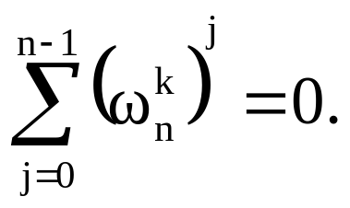
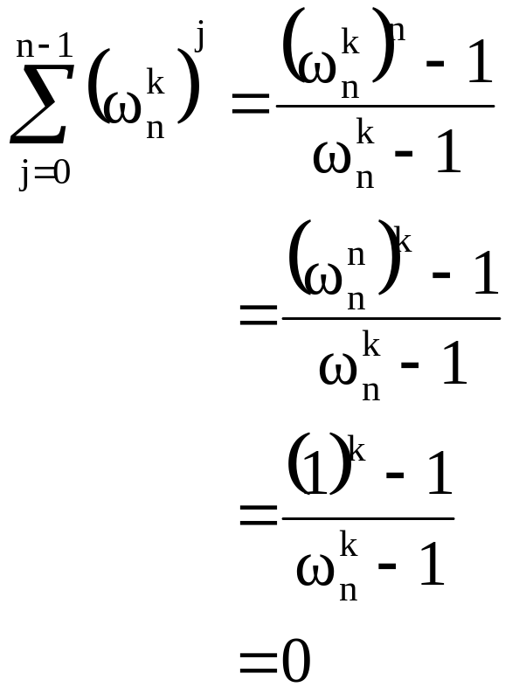
Summation Lemma
Lemma 30.6: For all n ≥ 1, k ≥ 0, where k is not divisible by n:
Proof:
Where is “k not divisible
by n” needed?

Slide 14
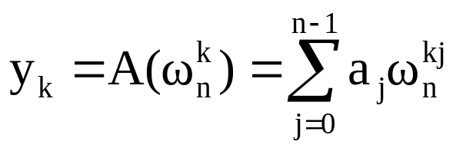
The DFT
We wish to evaluate at ω_{n}⁰, ω_{n}¹, …, ω_{n}^{n-1}.
W.o.l.o.g., assume n is a power of 2.
Define:
The vector y = (y₀, y₁, …, y_{n-1}) is called the Discrete Fourier
Transform (DFT) of the coefficient vector a = (a₀, a₁, …, a_{n-1}).
We write: y = DFT_{n}(a).
Our Goal: To compute y efficiently.

Slide 15
The Fast Fourier Transform (FFT)
The FFT computes DFT_{n}(a) in Θ(n lg n) time using a divide and
conquer approach.
Define: A^{[0]}(x) = a₀ + a₂x + a₄x² + … + a_{n-2}x^{n/2-1}
  A^{[1]}(x) = a₁ + a₃x + a₅x² + … + a_{n-1}x^{n/2-1}
Both are degree-bound n/2 polynomials.
Note: A(x) = A^{[0]}(x²) + x⋅A^{[1]}(x²).
Approach:
1. Evaluate A^{[0]}(x) and A^{[1]}(x) at (ω_{n}⁰)^{2,} (ω_{n}¹ )², …, (ω_{n}^{n-1} )².
2. Combine results using A(x) = A^{[0]}(x²) + x⋅A^{[1]}(x²).
So, we solve one problem of size n by solving two problems
(of the same form) of size n/2.
n/2 complex (n/2)^{th} roots of unity (by Halving Lemma)

Slide 16
Base Case
n = 1.
Applying to , 0 ≤ k < n, yields
y₀ = a₀ω₁⁰
= a₀ ⋅ 1
= a₀
So: y = (y₀) = (a₀) = a.

Slide 17
Code
Recursive-FFT(a)
1 n := length[a];
2 if n =1 then
3 return a
fi;
4 ω_{n} := e^{2πi/n};
5 ω := 1;
6 a^{[0]} := (a₀, a₂, …, a_{n-2});
7 a^{[1]} := (a₁, a₃, …, a_{n-1});
8 y^{[0]} := Recursive-FFT(a^{[0]});
9 y^{[1]} := Recursive-FFT(a^{[1]});
10 for k := 0 to n/2 – 1 do
11 y_{k} := y_{k}^{[0]} + ω y_{k}^{[1]};
12 y_{k+(n/2)} := y_{k}^{[0]} - ω y_{k}^{[1]};
13 ω := ω⋅ω_{n}
od;
14 return y
Time complexity:
T(n) = 2T(n/2) + Θ(n)
= Θ(n lg n)

Slide 18
Correctness
Lines 8 and 9 compute: y^{[0]}_{k} = A^{[0]}(ω_{n/2}^{k}) k = 0, …, n/2 – 1
  y^{[1]}_{k} = A^{[1]}(ω_{n/2}^{k}) k = 0, …, n/2 – 1
By the Cancellation Lemma: y^{[0]}_{k} = A^{[0]}(ω_{n}^{2k})
  y^{[1]}_{k} = A^{[1]}(ω_{n}^{2k})
For k = 0, 1, …, n/2 – 1 we get (line 11): y_{k} = y_{k}^{[0]} + ω_{n}^{k} y_{k}^{[1]}
= A^{[0]}(ω_{n}^{2k}) + ω_{n}^{k} A^{[1]}(ω_{n}^{2k})
= A(ω_{n}^{k})
We also get (line 12): y_{k+(n/2)} = y_{k}^{[0]} – ω_{n}^{k} y_{k}^{[1]}
= y_{k}^{[0]} + ω_{n}^{k+(n/2)} y_{k}^{[1]}
= A^{[0]}(ω_{n}^{2k}) + ω_{n}^{k+(n/2)} A^{[1]}(ω_{n}^{2k})
= A^{[0]}(ω_{n}^{2k+n}) + ω_{n}^{k+(n/2)} A^{[1]}(ω_{n}^{2k+n})
= A(ω_{n}^{k+(n/2)})

Slide 19
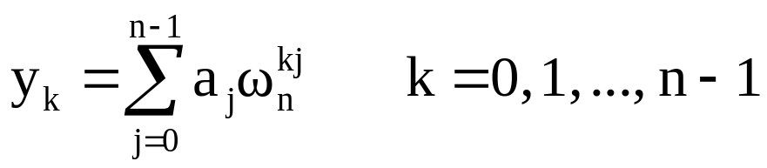
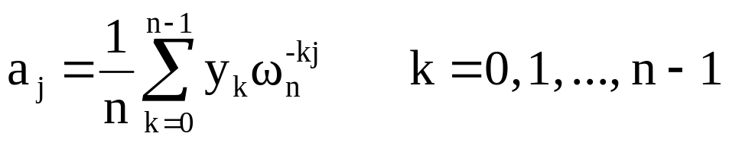
Interpolation
We just showed we can use the FFT algorithm to evaluate
in Θ(n lg n) time.
How do we interpolate (i.e., go from P-V back to coeff.)?
Can show
(See book ⎯ need the Summation Lemma here.)
So, with minor modifications, we can use the FFT algorithm to
interpolate in Θ(n lg n) time.

Slide 20
Speeding Up the Algorithm
Iterative-FFT(a)
Bit-Reverse-Copy(a, A);
n := length[a];
for s := 1 to lg n do
m := 2^{s};
ω_{m} := e^{2πi/m};
ω := 1;
for j := 0 to m/2 – 1 do
for k := j to n – 1 do
t := ωA[k + m/2];
u := A[k];
A[k] := u + t;
A[k + m/2] := u – t
od
ω := ω⋅ω_{m}
od od;
return A
Can speed up the FFT code
in practice by making it iterative
and eliminating common
subexpressions in loop.
Resulting code:
Bit-Reverse-Copy(a, A)
n := length[a];
for k := 0 to n – 1 do
A[rev(k)] := a_{k}
od
See book for explanation of
this code.

Slide 21
Final Comment
In signal processing applications, FFTs are often computed in hardware.
The book gives such a hardware circuit.

